Slide 1
Analyzing biodiversity through data
Codecademy Final Project

Slide 2
Biodiversity in plants

Slide 3
Key Questions
How are the total number of observations distributed across the four national park?
Do any genus’ or plant species have an exceptionally high or low number of observations? What can we conclude from this?
Which genus’ contain the largest and smallest number of unique species? Is this reflected by the number of observations collected from these plants?

Slide 4
General Objectives
Compare observations based on different variables, including parks, genus types, and plant species.
Compare which genus’ contain the least unique plant species and the most unique plant species.
Create a function that compares the total number of unique species according to genus name.
Create a function that compares the total number of observations for any given species according to national park.

Slide 5
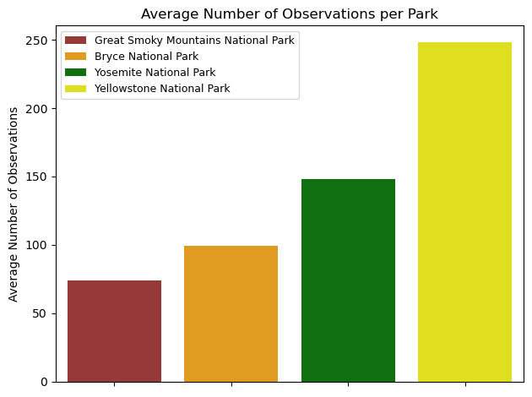
Observing Observations
The average number of observations per plant across all parks is 142.0. The park with the lowest average number of observations is the Great Smoky Mountains National Park, with an average of 74.0 observations. The park with the highest number of observations is Yellowstone National Park, with an average of 248.0 observations.

Slide 6
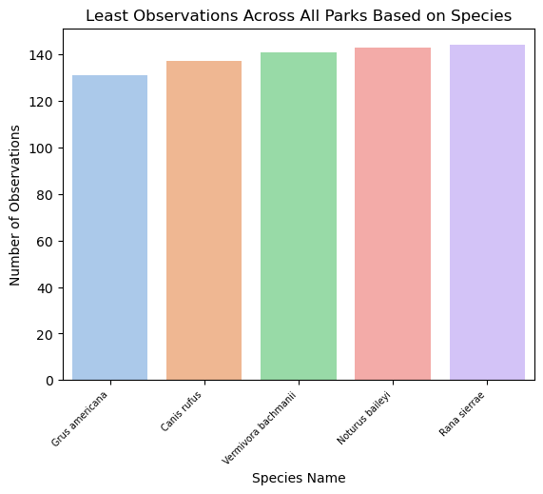
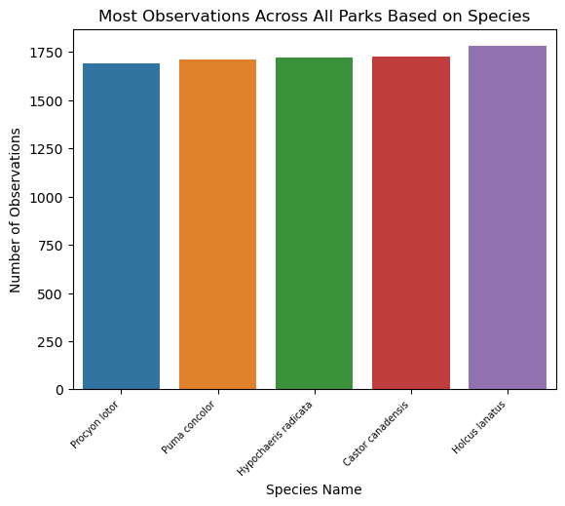
Popular Plants?

Slide 7
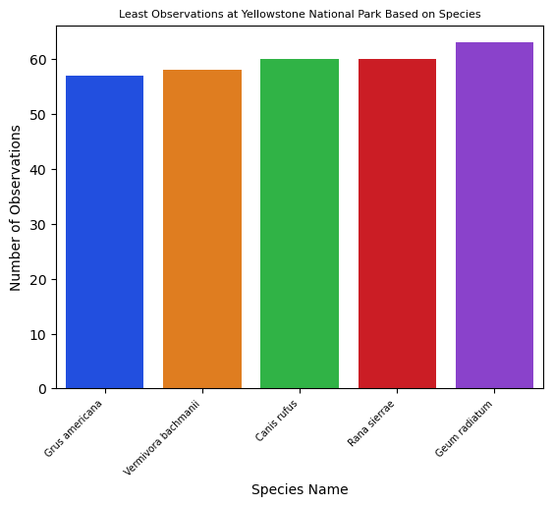
Popular Plants? (cont.)
If we take a closer look at the least most commonly observed species at Yellowstone National Park, we can see that it reflects information from the last slide, with species such as Grus Americana and Canis Rufus being among the least observed at Yellowstone and across all parks.

Slide 8
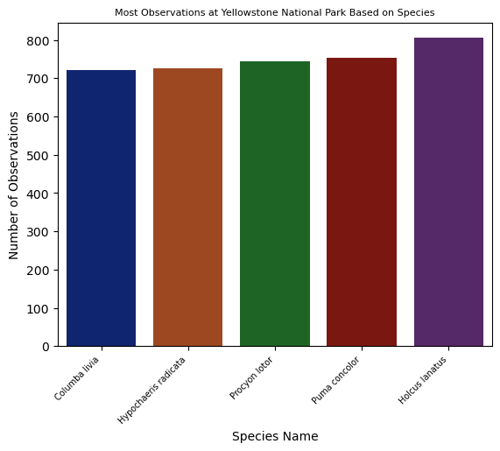
Popular Plants? (cont.)
Similarly, species such as the Holcus Ianatus and Puma Concolor are among the most frequently observed species in both Yellowstone and overall.

Slide 9
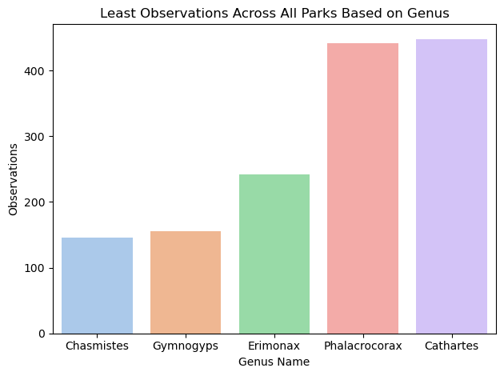
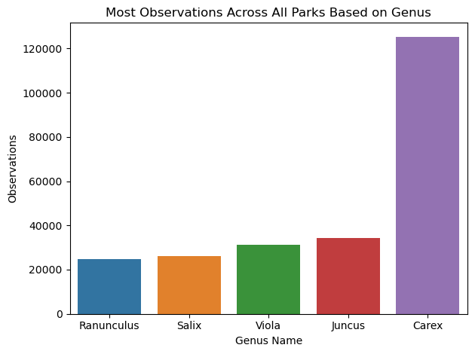
It Doesn’t Take a Genus…

Slide 10
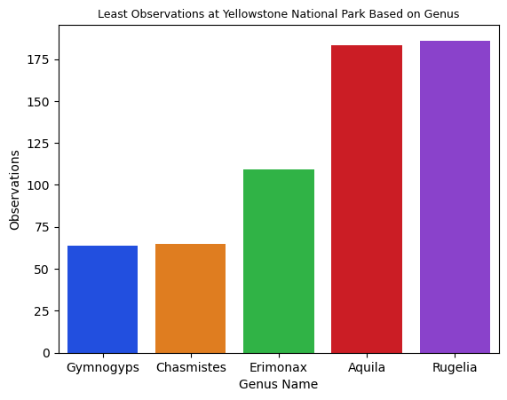
It Doesn’t Take a Genus…(cont.)
When grouped by Genus, we can see that Erimonax and Gymnomgyps are among the least frequently observed genus’ at Yellowstone and across all parks.

Slide 11
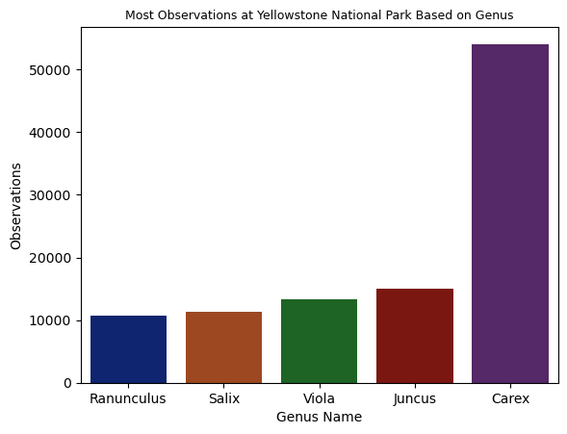
It Doesn’t Take a Genus…(cont.)
On a similar note, Carex and Juncus are among the most frequently observed Genus’ both overall and at Yellowstone, with the Carex genus containing more four times more observations that the next highest genus Juncus.

Slide 12
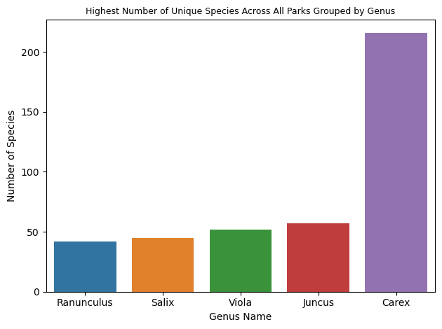
It Doesn’t Take a Genus… (cont.)
The genus Carex also contains the largest number of unique species across all four parks by a significant amount, with more than two hundred unique species. Meanwhile, the Juncus genus contains around fifty unique species, less than a quarter of Carex.

Slide 13
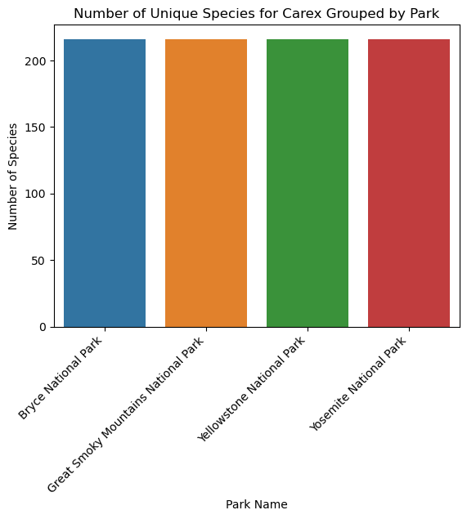
Considering Carex
It’s also worth noting that the total number of unique species observed for the Carex genus is consistent across all four parks, suggesting that many if not all the Carex species can be found in all four parks,

Slide 14
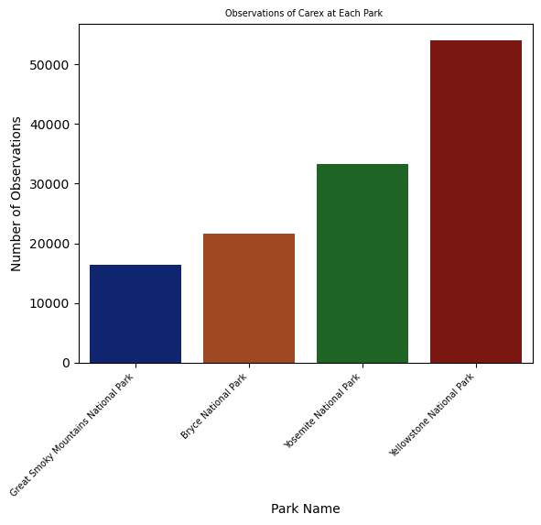
Considering Carex (cont.)
Plants from the Carex genus also draw most of their observations from Yellowstone park, despite the fact that the number of unique species are equal across all parks. This suggests Carex species are generally more frequently observed in Yellowstone.

Slide 15
Conclusions
Yellowstone National Park contains the most observations on average. However, the number of unique species per genus is also equally spread out among the four parks, suggesting that many species are observed more frequently at Yellowstone.
The Carex genus contains the highest number of unique species when compared to other genus’. However, none of these species are among the top five most observed species at Yellowstone or across all parks.
The number of total observations seems to be related to the number of unique species in a genus. For example, Carex has nearly four times as many unique species and total observations when compared to Juncus, the second most ‘popular’ genus.

